Slide 1
Aggie Hacks
Team: Three Shoe Makers

Slide 2
Main Question
Does Mobility trend have relationship with the spread of Coronavirus?
If it is true, how does the relationship look like?
To answer this question, we visualized the relationship between new confirmed cases and mobility trend provided by Google in each states at first.
Then we evaluate the correlation between those metrics to confirmed that relationship from statistics aspect.

Slide 3
Workflow
Data Warehouse
Data Processing
Data Modeling
Bigquery
Bigquery & Python(Google Colab)
R
Retrieve, filter and aggregate data
Create new dataset to store data
Remove 2% outliers for new confirmed cases data
Calculate 7-day moving average
Standardize variables
Time-lagged Cross Correlation
Correlation Matrix
Linear Regression

Slide 4
Data Source
Mobility data comes from Google Map. These datasets show how visits and length of stay at different places change compared to a baseline. The baseline is the median value, for the corresponding day of the week, during the 5-week period Jan 3–Feb 6, 2020. The datasets show trends over several months with the most recent data representing approximately 2-3 days ago—this is how long it takes to produce the datasets.
Google LLC "Google COVID-19 Community Mobility Reports". https://www.google.com/covid19/mobility/

Slide 5
Understand Data
Grocery & pharmacy Mobility trends for places like grocery markets, food warehouses, farmers markets, specialty food shops, drug stores, and pharmacies.
Parks Mobility trends for places like local parks, national parks, public beaches, marinas, dog parks, plazas, and public gardens.
Transit stations Mobility trends for places like public transport hubs such as subway, bus, and train stations.
Retail & recreation Mobility trends for places like restaurants, cafes, shopping centers, theme parks, museums, libraries, and movie theaters.
Residential Mobility trends for places of residence.
Workplaces Mobility trends for places of work.

Slide 6
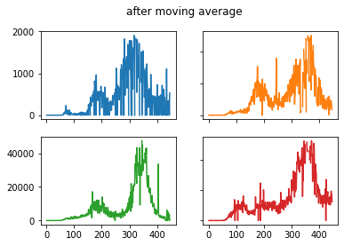
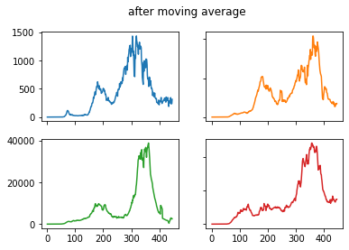
7-day Moving Average on new confirmed cases
*Data shown here comes from Idaho, Texas, California, Virginia

Slide 7
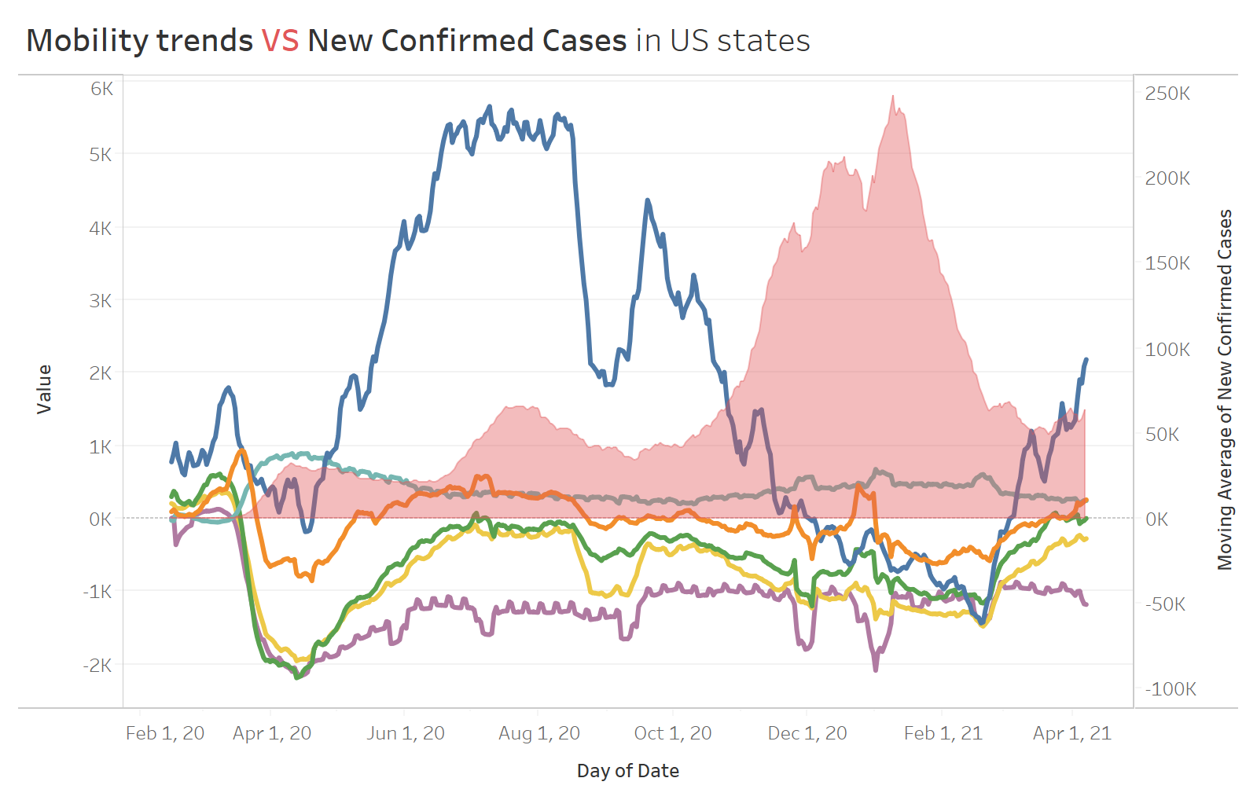
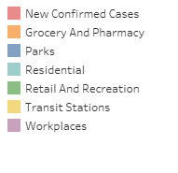
To view the interactive report for each states: https://public.tableau.com/profile/yuanfang.ping#!/vizhome/Covid-19_Mobility_trend/Dashboard
*Data source: https://goo.gle/covid-19-open-data
** 7-day running average value is used for the graph.

Slide 8

Cumulative Death in US states

Slide 9
Time-Lagged Cross Correlation
As we know, both the mobility trend and the number of new confirmed cases are time series. It is likely that the number of cases is related to the past lags of mobility trend because of the latent time and incubation period of virus. We used sample cross correlation function(CCF) to identify the lags of mobility trend variables that might be useful predictors of the number of new confirmed cases.
Mobility trend data and covid-19 cases number from Idaho are used in modeling.

Slide 10
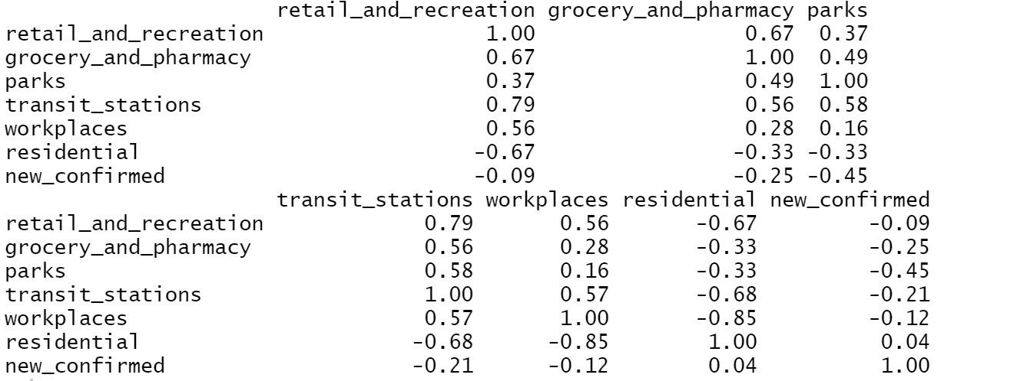
Correlation Matrix
High correlation between retail_and_recreation and transit_stations and between workplaces and residential.

Slide 11
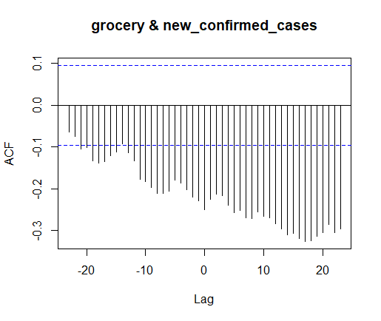
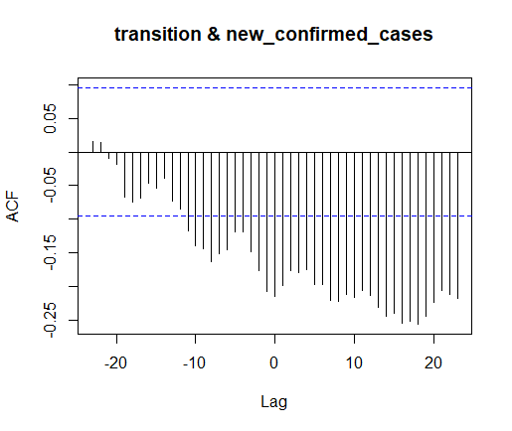
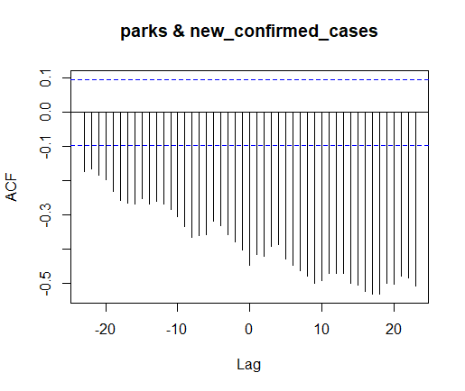
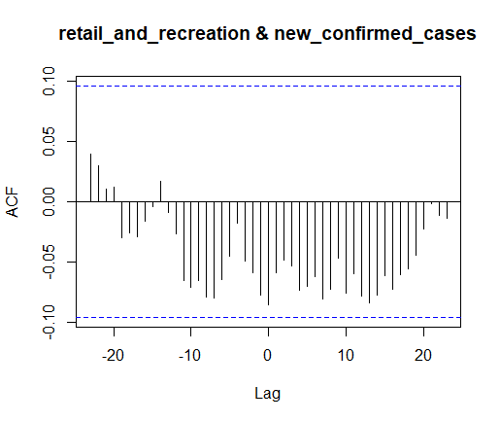
CCF plots for Mobility Trend variables
The most dominant cross correlation occurs at lag=-7 or -8 for retail and recreation variable.

Slide 12
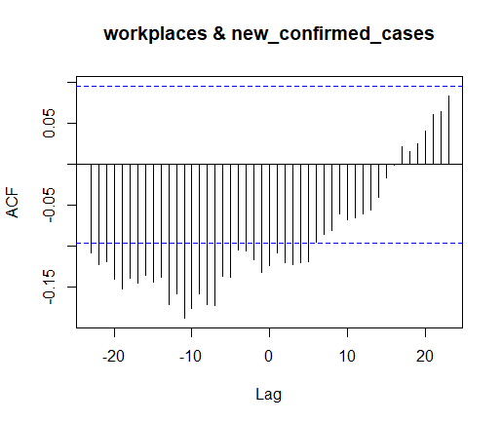
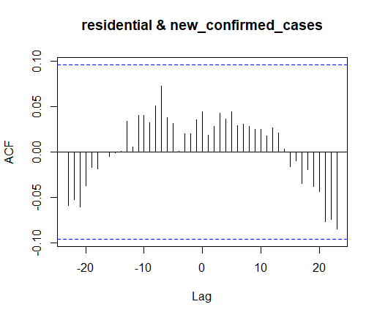
CCF plots for Mobility Trend variables
The most dominant cross correlation occurs at lag=-11 for workplace variable and at lag = -7 for residential variable. Exact lag number could be got from correlation values (next page).

Slide 13
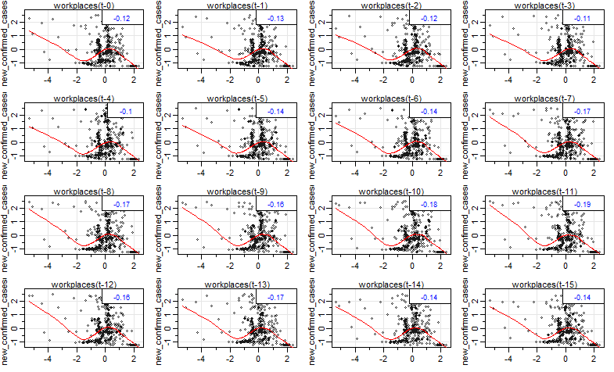
Scatter plots with correlation values
Workplace trend variable is used as example.

Slide 14
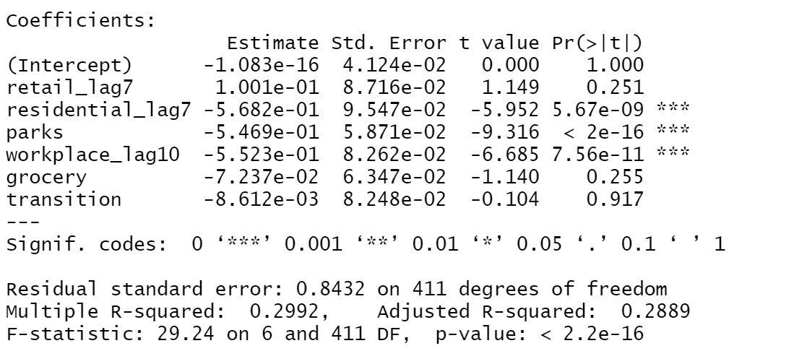
Linear Regression

Slide 15
Conclusion
New confirmed cases have strong correlation with variables residential trend with 7-days lag, park trend and workplace trend with 10-days lag in Idaho.
We could find that closing public areas like park and working from home could really help with control the spread of covid-19 in Idaho.
Future step would be to implement the model on the other states’ data to see they have the same phenomenon.

